Slide 1
NETL’s Minority Serving Institutions Program
NETL’s Engagement of MSIs
November 9, 2016

Slide 2
A Quick Overview of HBCU-OMI Program
In 1984, the Office of Fossil Energy (FE) took steps to expand university participation in its research program. It initiated the Historically Black Colleges and Universities Education Training program to expand learning opportunities for university students and increase collaborative efforts between the Nation's minority students and the fossil fuel industry. It was later broaden to include Other Minority Institutions (OMIs) also known as “Minority Serving Institutions” (MSIs)
The program has consisted of annual competitions (FOAs) administered by NETL where between $750,000 and $1,000,000 are made available for research and training at minority institutions. In the past several years, research focus has been on sensors and controls; computational energy sciences; and advanced materials for power generation technologies. Winning proposals become projects that are managed by Federal Project Managers at NETL.
The goal of the HBCU-OMI Program is to enhance research methods and capabilities of minority institutions that can help expand diversity for future generations of energy scientists and engineers.

Slide 3
What is a Minority Serving Institution?
MSIs include:
Historically Black Colleges and Universities (HBCUs)
Hispanic-Serving Institutions (HSIs)
American Indian Tribally Controlled Colleges and Universities (TCUs)
Native Hawaiian-Serving Institutions
Alaska Native-Serving Institutions
Asian American and Native American Pacific Islander-Serving Institutions (AANAPISIs)
Native American-Serving, Nontribal Institutions
Predominantly Black Institutions (PBIs)
As designated by the U.S. Department of Education, under part F of the HEA, 20 U.S. Code § 1067q

Slide 4
Funding HBCU-OMI Program
The central thrust of the program is to generate fresh ideas and tap unique talent, define applicable fundamental scientific principles, and develop advanced concepts for generating new and improved technologies across the full spectrum of fossil energy R&D programs.
The program is driven by the need for a diverse new generation of scientists and engineers with hands-on experience in coal-related research entering into the Nation’s workforce and the understanding that HBCUs and OMIs have traditionally been the institutions charged with educating minority students

Slide 5
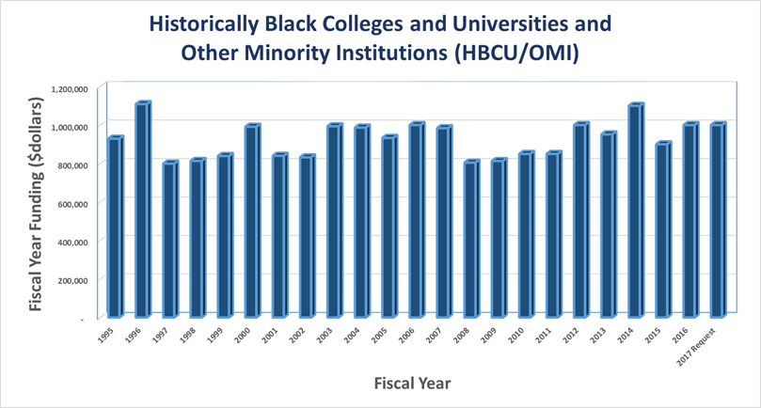
Funding HBCU-OMI Program
Congress designates funding for the HBCU/OMI Program by including it in Fossil Energy’s annual budget under the Crosscutting Research and Analysis line item.
The graph shows the funding levels of the HBCU-OMI Program over the last 22 years.

Slide 6
Funding Opportunity Announcement (FOA)
FOA TITLE
“Support of Fossil Energy Research and U.S. Colleges and Universities Including University Coal Research (UCR) and Research by Historically Black Colleges and Universities (HBC) and Other Minority Institutions (OMI)”
Typically, the FOA is issued in the latter part of the calendar year
Remember that, while your institution qualifies to apply for HBCU-OMI grants, it also qualifies to apply for UCR grants. Usually, topics for each grant type are different. If HBCU-OMI topics are not of interest to you, perhaps one on the UCR side might be.

Slide 7
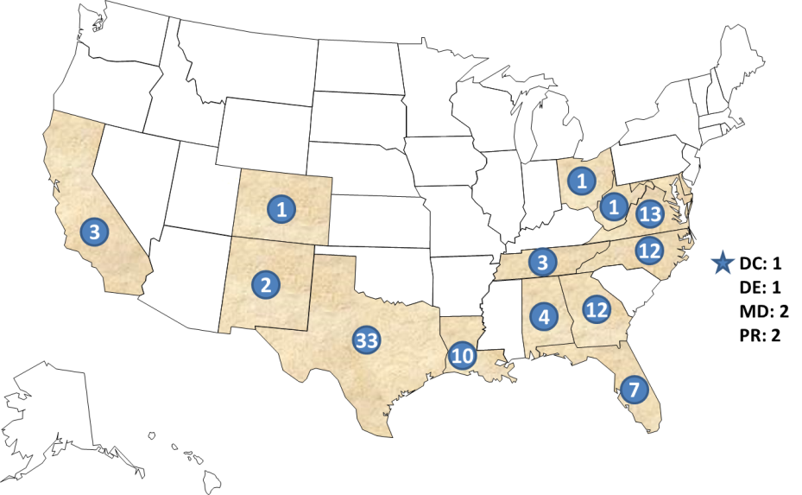
Results from Grants Awarded by this Program
Each grant typically involves 3-5 students throughout the duration of the project.
Students are expected to present project progress at annual review meetings.
Grants Awarded – By State
Period FY95 to FY14
Program Results:
500+ Technical Papers
5+ Technical Awards
2 Patents Issued to Date
For period FY95-FY14:
110 grants awarded to
28 HBCU/OMIs in
17 states

Slide 8
Goals of NETL’s HBCU-OMI Program
For the Program to reach the intended population – i.e. U.S. minority students.
For the minority student to benefit by obtaining a high level and quality of learning experience through participation in research activities that impact the Nation and possibly the World.
For the minority student to have the opportunity to present progress reports and final results at professional venues thus obtaining exposure and valuable experience.
For the research project to be used as a teaching tool by the faculty acting as Principal Investigator aimed at the student population that, by being part of a minority group, allows the institution to be designated an MSI and be able to take advantage of this funding opportunity.

Slide 9
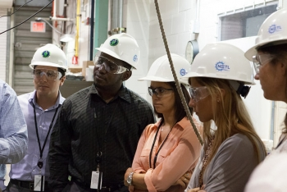
For information on the HBCU-OMI Program, contact Maria Reidpath Project Manager maria.reidpath@netl.doe.gov
And visit NETL’s website:
www.netl.doe.gov

